Slide 1
Does Asymmetric Information Drive Capital Structure Decisions?
Bharath, Pasquariello, & Wu (2009)
Presented by Nicholas Thompson

Slide 2
Research Question
Does asymmetric information drive capital structure decisions?

Slide 3
Prior Literature
Myers (1984) argues that, assuming managers know more about their firm’s value than the market, the market will penalize stock issuances, resulting in “pecking order theory,” the prediction that firms will use stock issuances to cover financing deficits only as a last resort after exhausting cheaper, less information-sensitive alternatives like internal cash or debt.
Tests of the prediction are mixed. This paper instead tests the underlying assumption, information asymmetry, by constructing a novel index of it.
The market microstructure literature contains direct measures of adverse selection, such as the adverse selection portions of both the quoted and Roll’s (1984) effective bid-ask spread (as in George, Kaul, & Nimalendran, 1991), the return volume coefficient of Llorente et al. (2002), and the probability of informed trading of Easley et al. (1996).

Slide 4
Data
Firm data: Each firm in COMPUSTAT database within each fiscal year between 1972 and 2002 (excluding financial firms, regulated utilities, firms involved in major mergers, firms with missing book value of assets, and firms that report format codes 4, 5, or 6)
Stock price data: CRSP
Insider trading data: Securities and Exchange Commission (SEC) Ownership Reporting System (ORS)

Slide 5
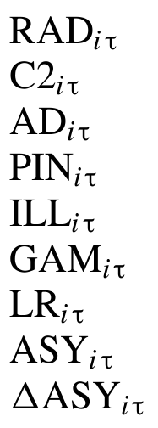
Index Constituents
Adverse selection portion of Roll’s (1984) effective spread (George, Kaul, & Nimalendran, 1991)
Return-volume coefficient (Llorente et al., 2002)
Adverse selection portion of quoted spread (George, Kaul, & Nimalendran, 1991)
Probability of informed trading (Easley et al., 1996)
Illiquidity ratio (Amihud, 2002)
Reversal coefficient (Pastor and Stambaugh, 2003)
Amivest liquidity ratio (Cooper, Groth, & Avera, 1985; Amihud, Mendelson, & Lauterbach, 1997)
Adverse selection index—the first principal component of available proxies in each year
Year on year change in adverse selection index
Notes:
The four direct measures of adverse selection (red dots) are from the market microstructure literature.
The three broader measures of market liquidity (blue dots) are more widely available, but not driven exclusively by adverse selection (they also depend on order processing and inventory).
Utilizing principal component analysis to weigh each feature enables the authors to retain more datapoints.

Slide 6
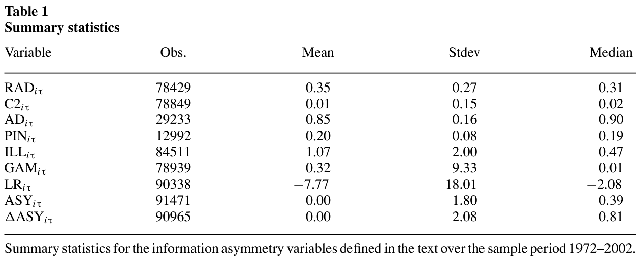
Notes:
Observations for direct measures of information asymmetry are fewer than for indirect, which is the reason principal component analysis is useful to retain datapoints.
Signs for the means are all as expected, which implies information asymmetry is present.
The information asymmetry index mean is set to zero because it is relative for each year.

Slide 7
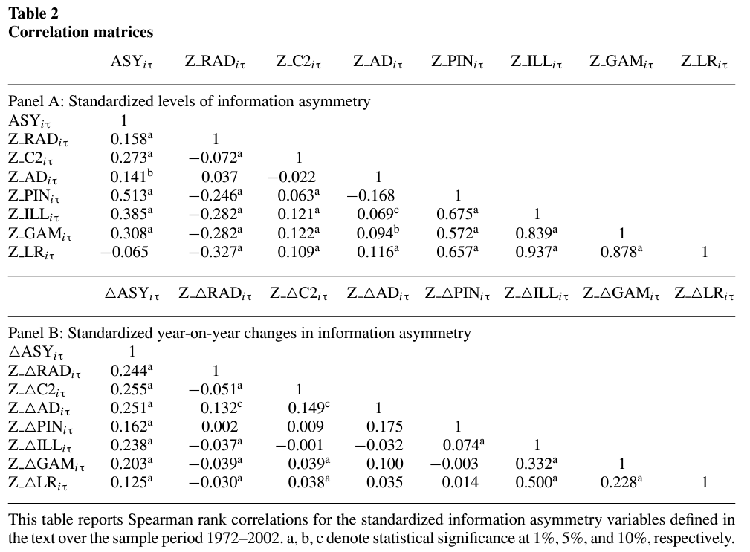
Notes:
The standardized proxies are mostly positively correlated with each other (excluding Z_RADiτ and Z_ΔRADiτ).
The highest correlation with level of the index, and the three highest correlations with change in the index, are direct measures.
The paper specifies that the index loads on at least three of the direct measures in each of the fiscal years of the sample.

Slide 8
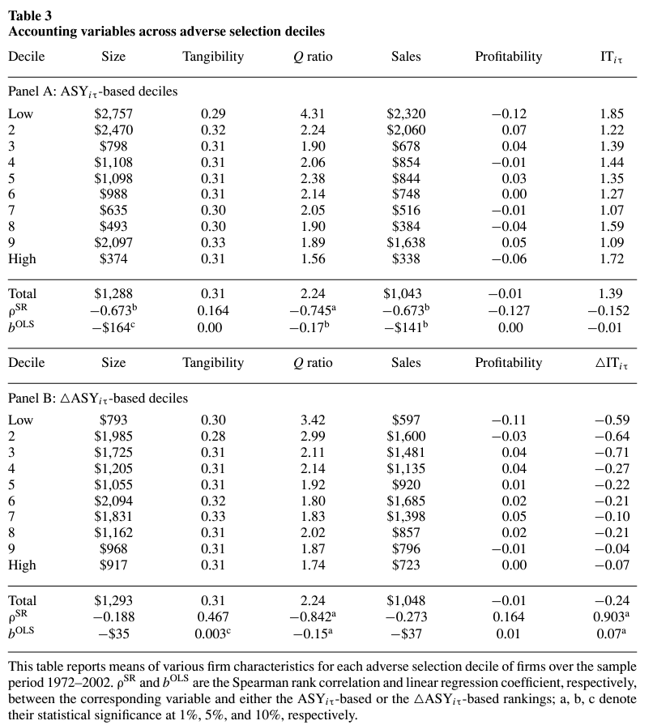
Notes:
Q ratio negatively correlates with both level of and change in information asymmetry.
Size and sales negatively correlate with level of information asymmetry.
Change in insider trading positively correlates with change in information asymmetry.
Conclusion: The index mostly agrees with the ex ante firm characteristics often used as proxies for information asymmetry, but has the added benefit of capturing the dynamic component.

Slide 9
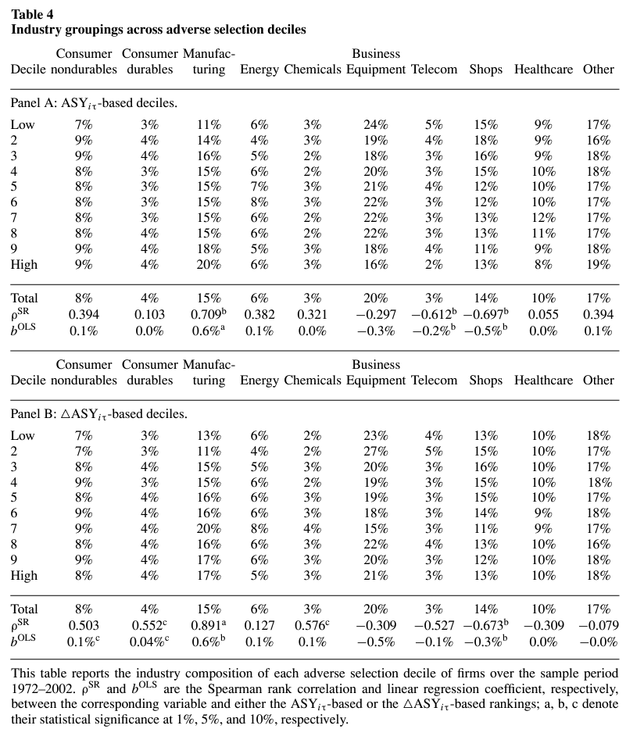
Notes:
Mostly, industry doesn’t relate to adverse selection. However, manufacturing firms are more likely, and shops firms less likely, to fall into high information asymmetry deciles.

Slide 10
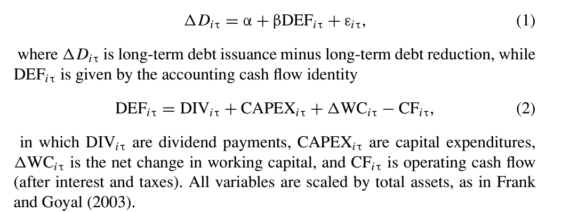
Notes:
Strict pecking order theory implies that the regression coefficient β in Equation (1) is close to one because firms use stock issuances as a last resort.
Modified pecking order theory, recognizing the tradeoff between adverse selection costs and financial distress when too much debt is issued, instead predicts a greater coefficient for firms with higher information asymmetry.
Equation (3) includes an interaction term of DEFiτ and ASYiτ (γ).

Slide 11
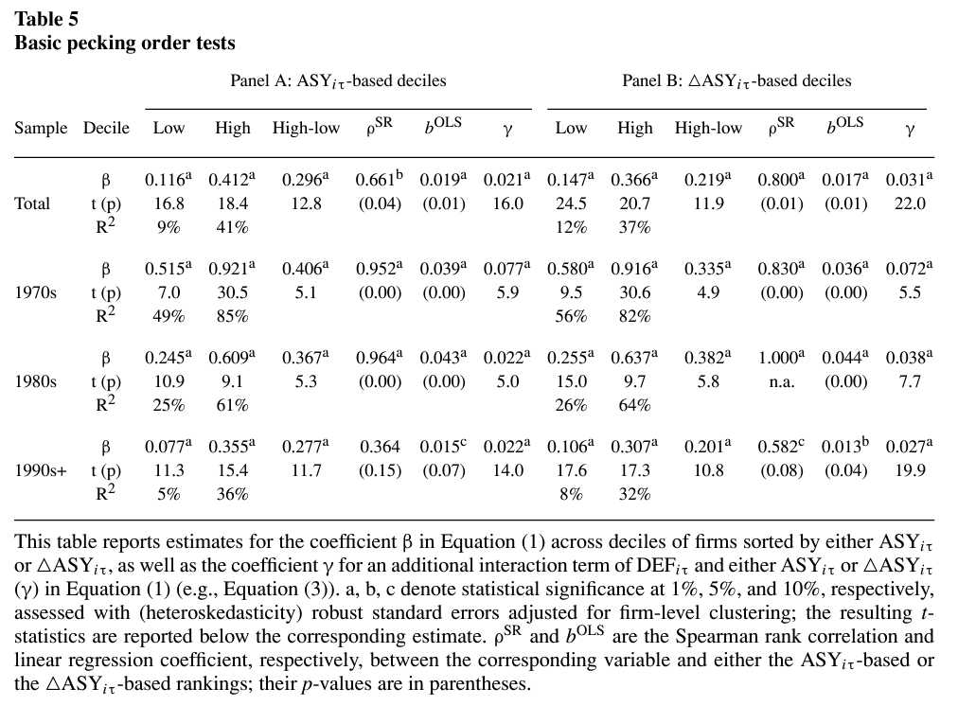
Notes:
Positive and statistically significant slope statistics indicate that the β coefficients are nearly monotonically increasing in the severity of firms' information asymmetry.
γ=0.021 implies that, on average, for every dollar of financing deficit to cover in a fiscal year, firms whose adverse selection index is a unit greater than the mean that year issue two cents more of debt.
High-low=0.296 implies that, on average, for every dollar of financing deficit to cover, firms in the highest ASYiτ decile issue 30 cents more of debt more than firms in the lowest ASYiτ decile.
These trends hold up across decades, albeit less so in the 1990s, and in similar directions for both level of and change in adverse selection.

Slide 12
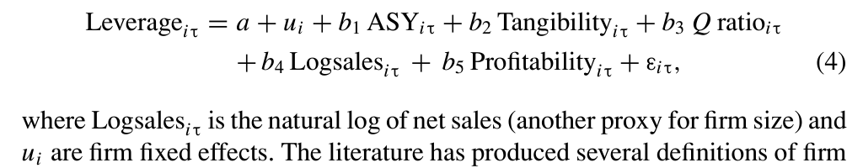
Notes:
Incorporates firm fixed effects and other factors that drive leverage to ensure information asymmetry index has incremental value in predicting leverage

Slide 13
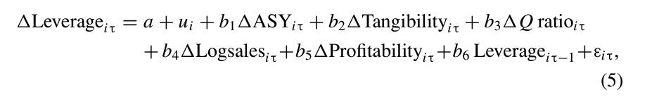

Slide 14
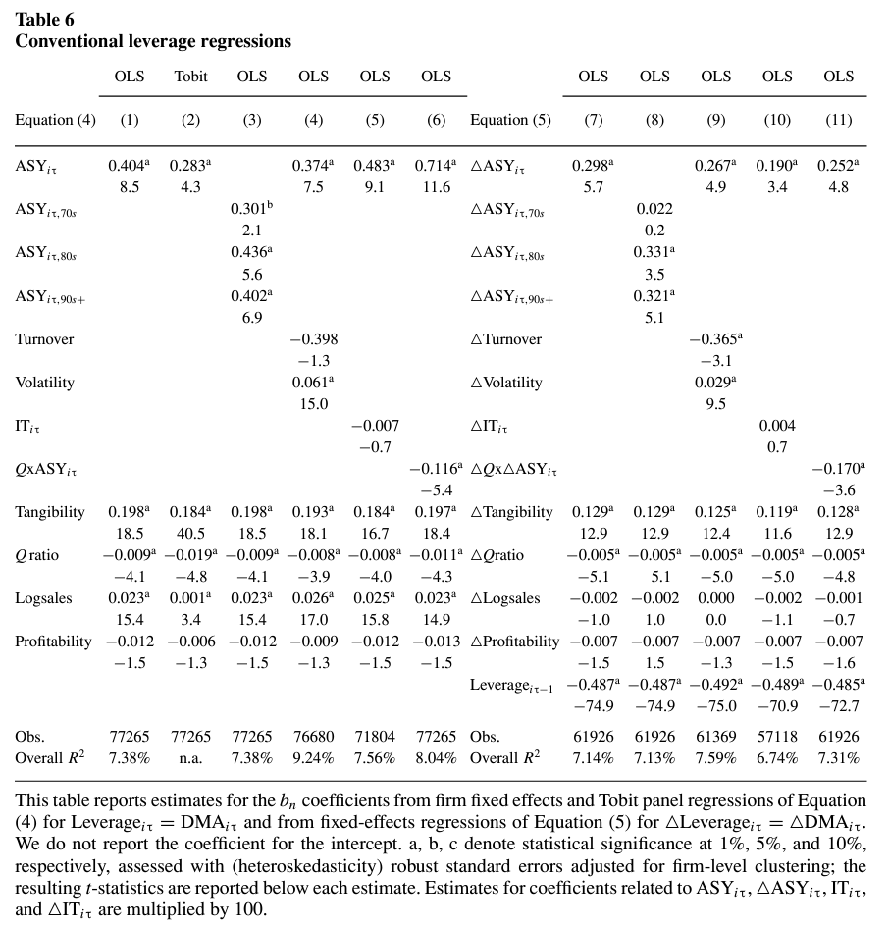
Notes:
Coefficients of conventional leverage factors are of the correct sign and significant, but so is the information asymmetry variable in all OLS models shown. Interpretation: The inclusion of the adverse selection proxy does not supersede conventional variables, but still helps to explain the cross-sectional variation in firms' capital structures.
Note: The inference is the same even when including turnover and volatility (noninformational drivers of stock liquidity), insider trading, or an interaction term of the Q ratio and ASYiτ.
Note: The relationship holds less in the 1970s, especially for ΔASYiτ.

Slide 15
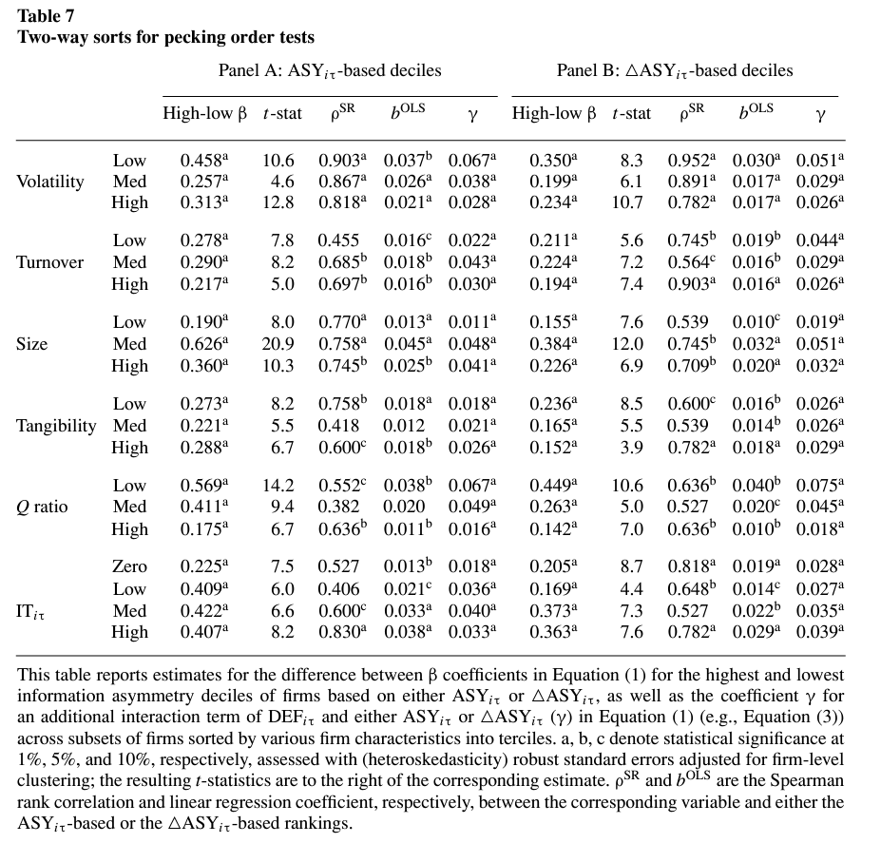
Notes:
Two-way sorts suggest the relationship previously described still holds: High-low debt-deficit coefficients β are generally increasing in adverse selection deciles in all of the volatility and turnover terciles. For instance, column b^OLS indicates that, on average, for every dollar of financing deficit to cover, firms in each turnover tercile issue nearly two additional cents of debt more than firms in the same turnover tercile but in the next lower information asymmetry decile.
The idea is to 1) correct for volatility and turnover that is wrapped up in the liquidity measures, 2) account for findings that small firms and firms with less tangible assets have greater information asymmetry, yet take on less debt, 3) show that information asymmetry matters more when there are greater assets in place, and 4) mitigate the concern that propensity of insider trading is a better proxy than the index.

Slide 16
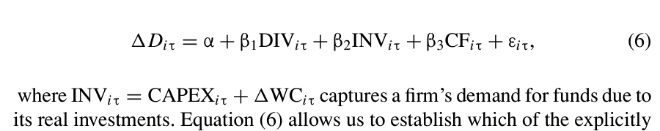
Notes:
This accounts for firms with no growth opportunities not issuing debt because they have no investment opportunities by separating out the investments component.

Slide 17
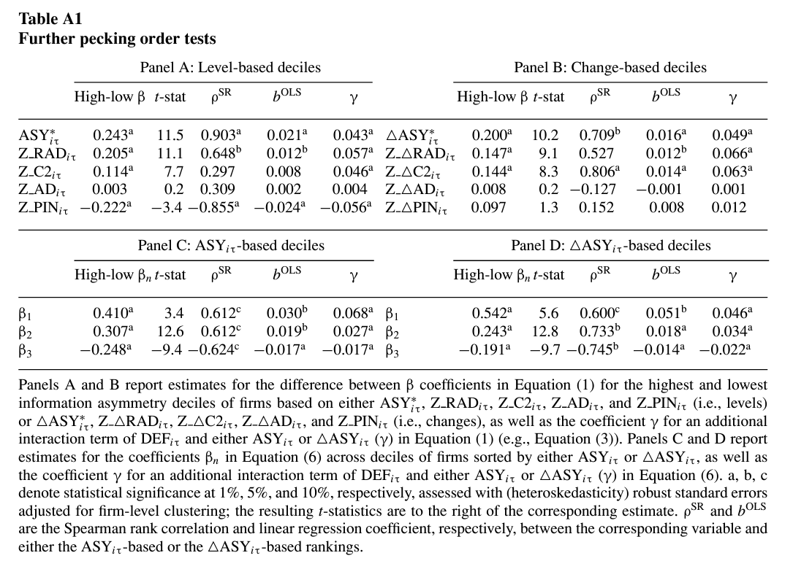
Notes:
A and B: Previous inference unaffected when only using the four market microstructure measures at the cost of smaller sample coverage.
C and D: β1, β2, and |B3| show that the relationship holds even when deficits are broken into individual components.

Slide 18
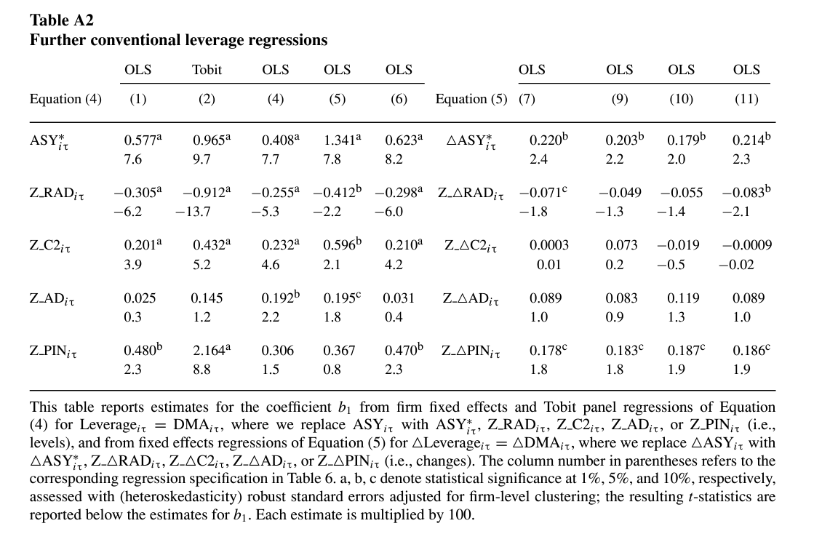
Notes:
Previous inference unaffected when only using the four market microstructure measures at the cost of smaller sample coverage. Also, note that most of the metrics perform reasonably well individually, but not as well as the index.

Slide 19
Conclusion
The authors use a novel information asymmetry index based on level of or change in adverse selection to reexamine pecking order theory, relying on measures of the market’s assessment of adverse selection from the market microstructure literature rather than ex ante firm characteristics.
Asymmetric information is an important determinant of the cross section of level and change in leverage of U.S. firms over the period.
The results do not corroborate a strict interpretation of pecking order theory; rather, they indicate that a modified pecking order theory finds the greatest support when its assumption of adverse selection holds.

